Slide 1


Data Analytics to improve Road Safety
Data collected from Data.gov.uk

Slide 2

Why Road Safety Analysis is Important?
World Health Organization (WHO) reported approximately 1.3 million people die each year as a result of road accidents.
Between 20 million and 50 million people and more suffer non-fatal injuries or disabled
Road accidents is the leading killer of children and young people worldwide
We will look at what factors that cause road accidents and who are the most vulnerable?

Slide 3
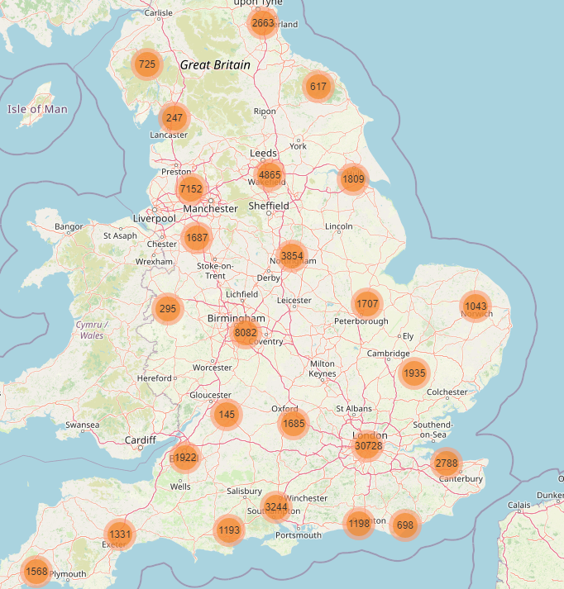
In 2020, despite the deaths caused by Covid-19, around 23000 people killed or seriously injured in Great Britain alone
Great Britain still witnessed around 3.3 million accidents in 2020 alone

Slide 4
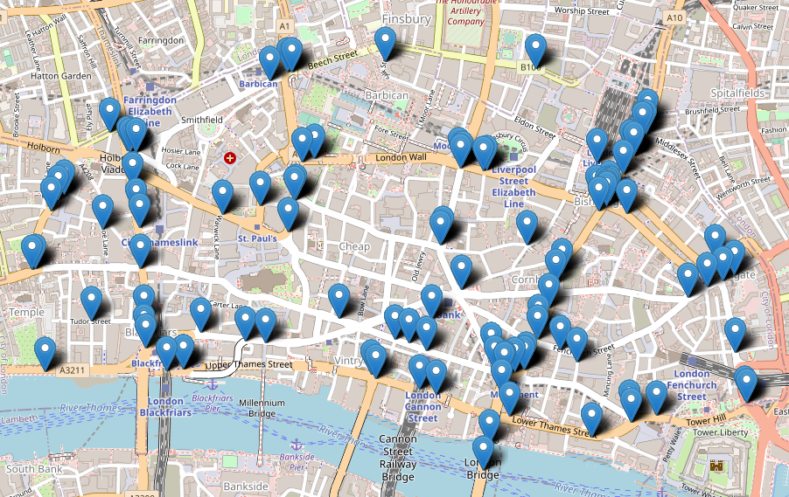
I am sure Driving over the Iconic London Bridge is Beautiful!
It is also the location where most accidents happen in the UK

Slide 5
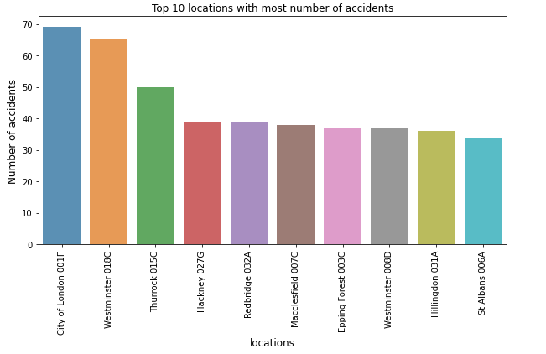
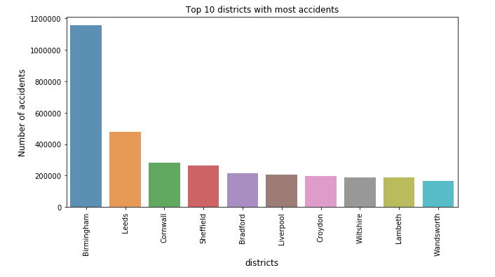
Top 10 Places/Locations for road accidents
Most tourist destinations like London bridge, Piccadilly Circus witnessed more accidents
Birmingham, the second largest city of the United Kingdom. It lies in the geographic center witnessed the greatest number of accidents

Slide 6
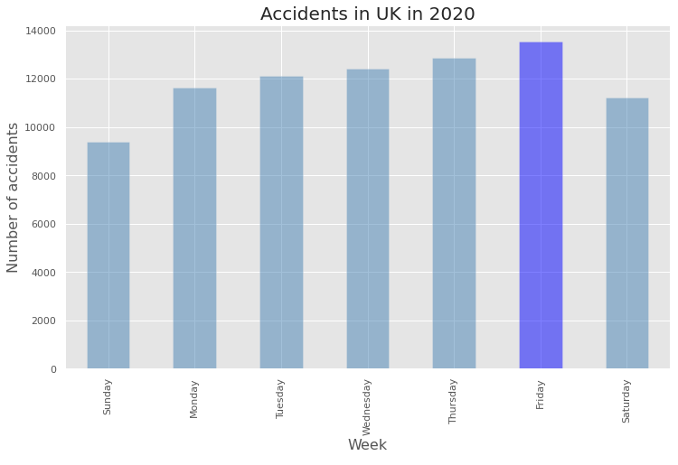
Number of Accidents by the Day of the week
Fridays are the most common day of the week to have an accident
Sundays are the least common

Slide 7
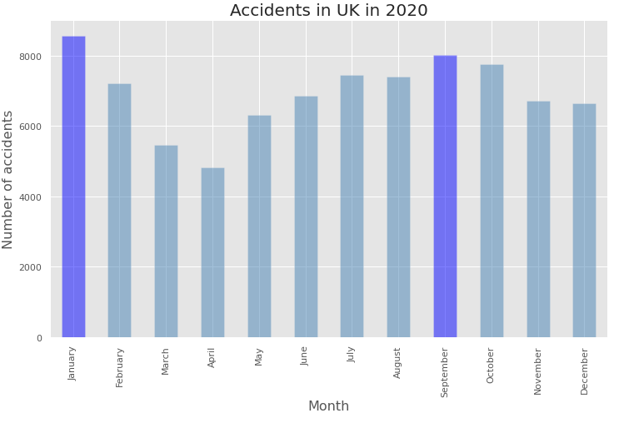
Number of accidents by Month
This dataset is from 2020, March and April, the road traffic was less due to COVID
Number of accidents were the greatest in January due to vacation season

Slide 8
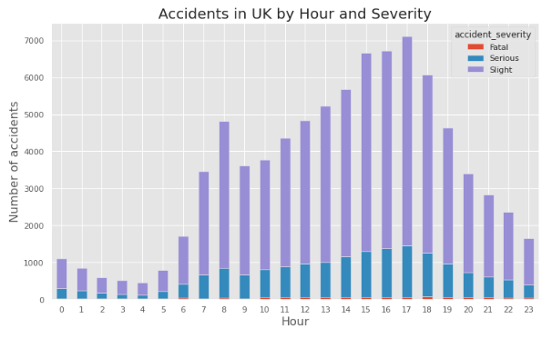
Number of accidents by the hour
It can be observed that the riskiest hour on UK roads is from 3 PM till 6 PM
Around this time, one can also face more serious accidents. It is better to stay more vigilant.

Slide 9
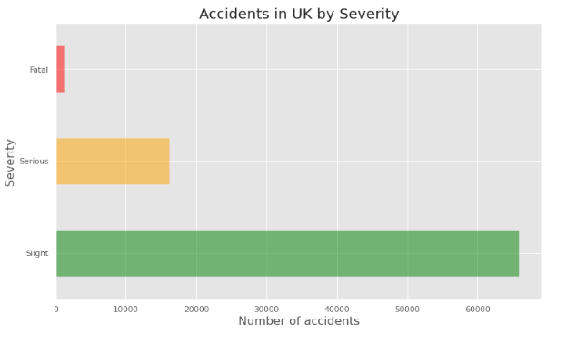
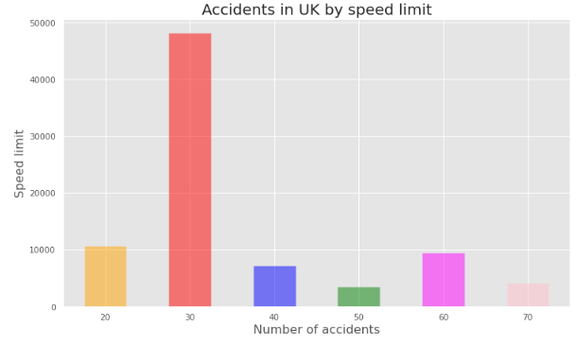
Number of accidents by Speed Limit
Most number of accidents happen at 30 kmph and therefore resulted in slight injuries

Slide 10
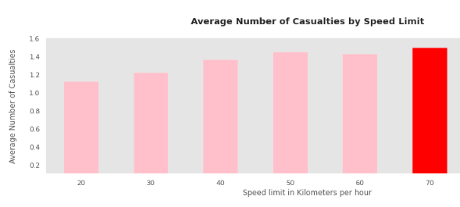
Which speed causes more Casualty?
Over speeding causes more casualties
It can cause drivers to lose control of their vehicles and decrease the effectiveness of safety mechanisms

Slide 11
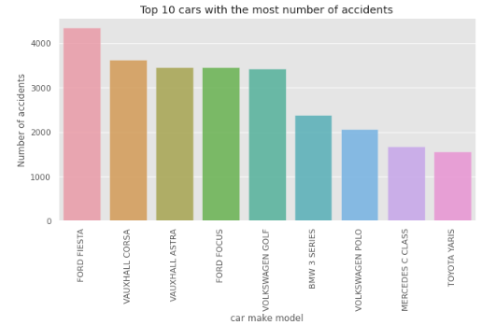

Slide 12
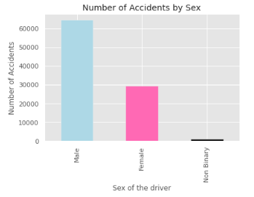
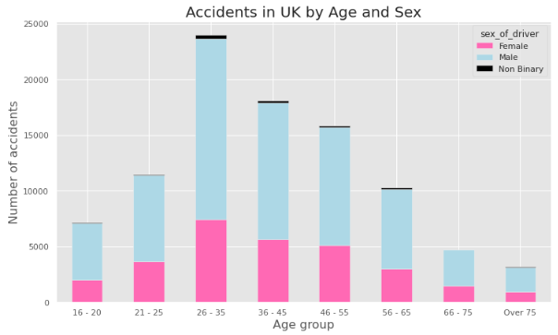
Who are most likely to encounter an accident?
Male drivers are more likely to end up in an accident
Drivers in the age group 26-37 are more likely to end up in an accident

Slide 13
What did we learn?
We learnt that most popular locations is where the accidents frequently occur, the government should take more preventive actions on these areas
Accidents commonly occur on Fridays and while driving at 30 kmph
Accidents that occur on speed limit above 50 kmph are the most fatal
Ford fiesta is the most common car involved in accidents, the government should check if it meets safety conditions
People at the age group of 26-37 are usually involved in accidents

Slide 14
Thank you
For the dataset information, please check out:
https://datasetsearch.research.google.com/search?src=0&query=dataset&docid=L2cvMTFqOWI5dzQ5Ng%3D%3D&filters=WyJbXCJ1cGRhdGVkX2RhdGVcIixbXCIxeVwiXV0iXQ%3D%3D&property=dXBkYXRlZF9kYXRl

